Slide 1


AtliQ Technologies
WAVECON TELECOM
ANALYSIS
IMPACT OF 5G
Presented by : Sachin Savkare
This presentation was developed during the Data Analytics Internship at AtliQ Technologies, facilitated by Codebasics.

Slide 2

WAVECON TELECOM – POWERING INDIA'S DIGITAL FUTURE
Leading the 5G Revolution
Wavecon Telecom is a leading telecom company in India, known for its innovative services and customer-first approach. Operating in 15 major cities, Wavecon offers a wide range of plans from budget-friendly to premium designed to meet the needs of diverse users.
In May 2022, they launched 5G services, delivering faster and more reliable internet for both individuals and businesses, marking a new chapter in technological excellence.

Slide 3
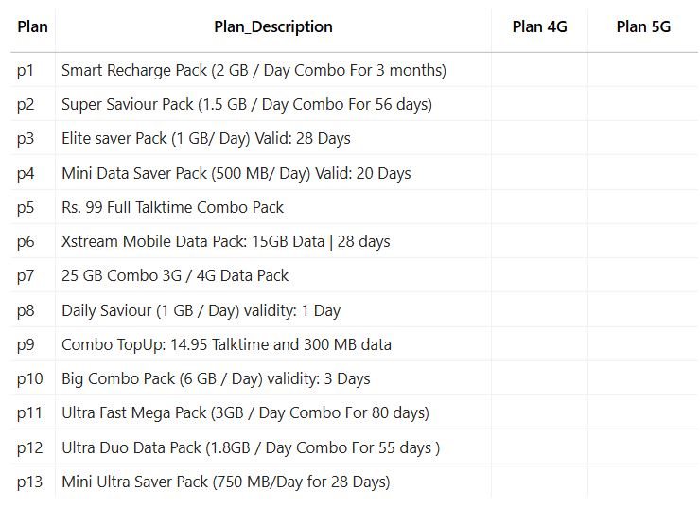
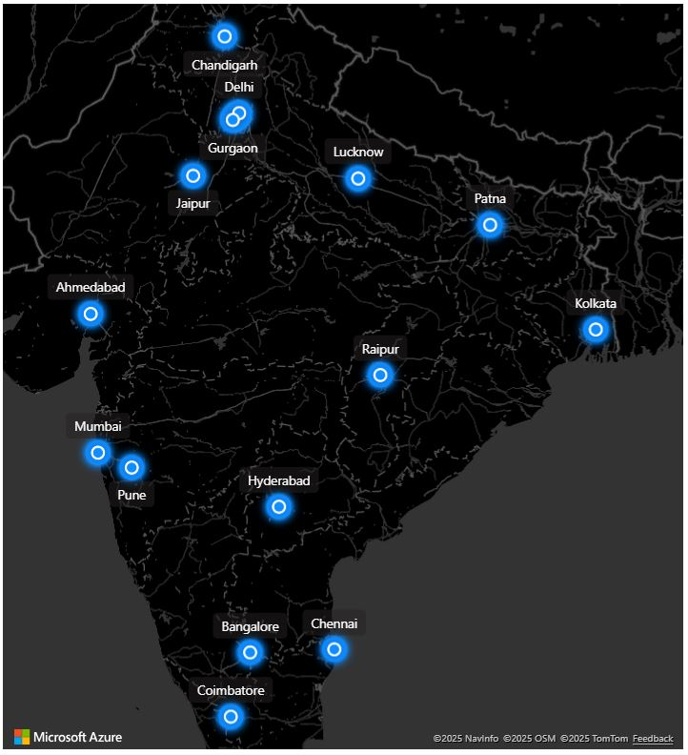


Wavecon 5G Plans and Market Position in India
🆕
🆕
🆕
Before 5G
JAN
FEB
MAR
APR
Year 2022
MAY
After 5G
JUN
JUL
AUG
SEP
Launch 5G

Slide 4
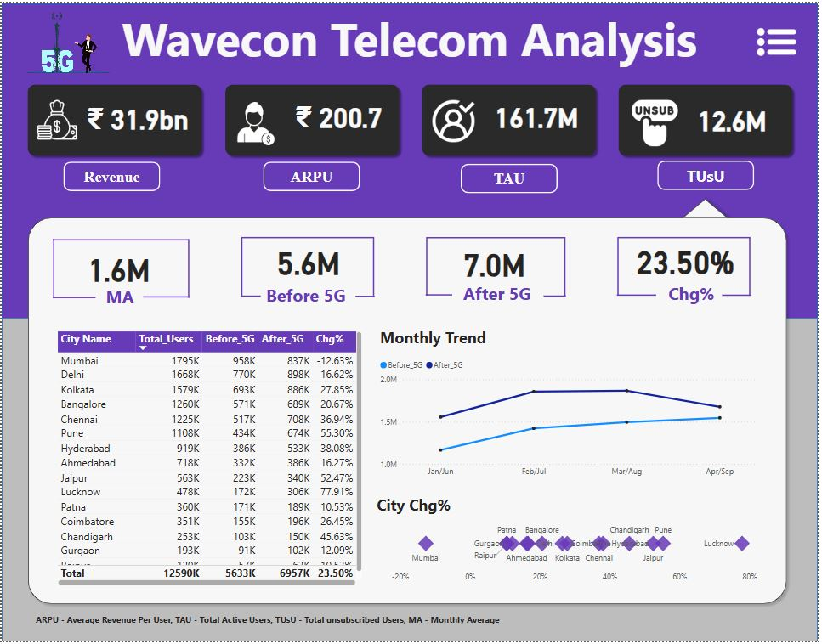
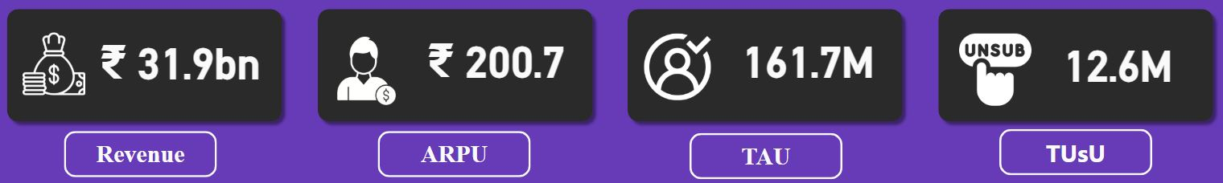
Wavecon 5G Performance Dashboard & Key KPIs
powered by AtliQ Technologies
AtliQ Technologies proudly presents an interactive Power BI dashboard built for Wavecon Telecom to explore their performance since the 5G launch. In this presentation, we’ll dive into powerful insights revealing revenue shifts, top-performing plans, customer trends, and smart recommendations to drive future growth and innovation.
This is Overall Total Revenue = 31.9 billion Rupees
APRU (Average Revenue Per User) = 200.7 Rupees
TAU (Total Active Users) = 161.7 million users
TUsU (Total Un-Subscribe Users) Which is 12.6 Million users

Slide 5

Requirements
Leading the 5G Revolution
1
What is the impact of the 5G launch on our Revenue ?
2
Which KPI is underperforming after the 5G launch ?
3
After the 5G launch , which plans are performing well in terms of revenue ? Which plans are not performing well ?
4
Identify the plans most negatively impacted post-5G launch and evaluate whether they should be retained, restructured, or phased out.
5
Which plans were discontinued following the 5G rollout, and what were the key factors behind their discontinuation?

Slide 6

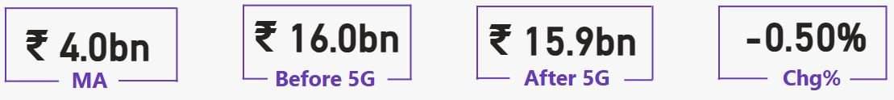
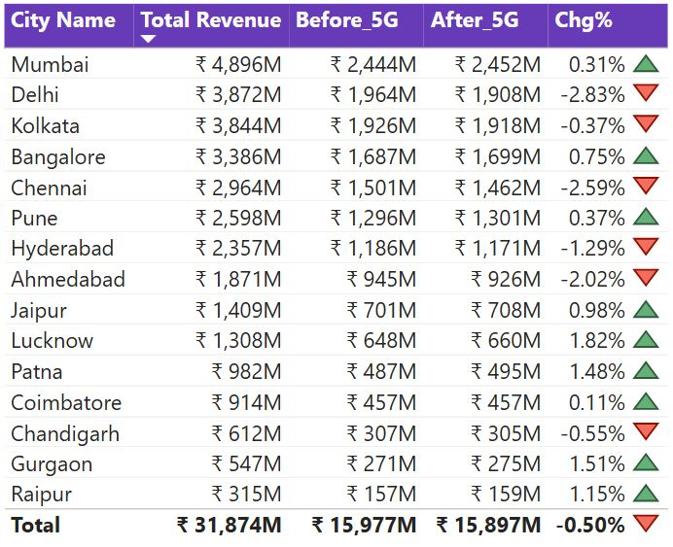


PROBLEM STATEMENT
1
What is the impact of the 5G launch on our Revenue ?
Executive Summary
Overall Impact: Marginal negative revenue shift post-5G launch.
Total revenue dropped by ₹80M, i.e., from ₹15.977B to ₹15.897B, a -0.50% change.
The impact is not uniformly negative; several cities show positive growth.
T1
"60% of cities (9 out of 15) witnessed revenue growth after 5G implementation."
T2
T3
“40% of cities (6 out of 15) saw negative revenue impact after 5G implementation."

Slide 7
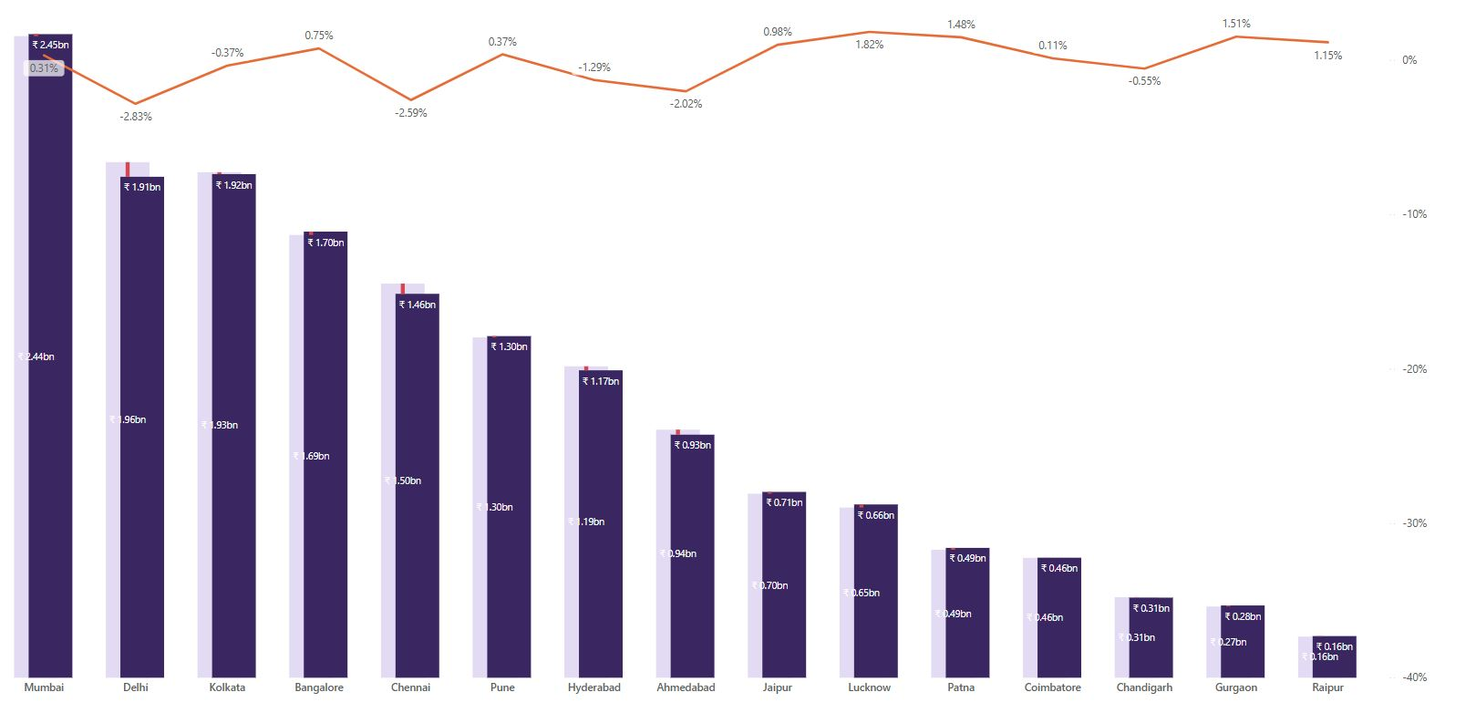
INSIGHT
1. Cities with Positive Growth Post-5G
Gurgaon: +1.51% (T3) - Highest positive growth rate.
Patna : +1.48% (T3) , Raipur +1.15% (T3), and Lucknow +1.82% (T2) also saw strong gains.
These smaller cities suggest latent market potential for 5G monetization.
2. Major Cities Underperforming (T1)
Delhi: -2.83% (T1) Steepest drop among top cities.
Chennai -2.59% (T1) and Ahmedabad -2.02% (T2) also declined notably.
Indicates possible saturation, customer resistance, or rollout issues in metros.
3. Revenue Concentration
Top 5 cities (Mumbai, Delhi, Kolkata, Bangalore, Chennai) account for ~55% of total revenue.
Yet only Mumbai (+0.31%) and Bangalore (+0.75%) showed growth.
4. Minimal Impact in Tier-2 & Tier -3 Cities
Cities like Pune, Jaipur, Coimbatore, Chandigarh show flat revenue , suggesting neutral customer response or limited 5G outreach.
Before 5G vs After 5G
Areas of Concern
Metro Market Fatigue: Delhi and Chennai’s decline may signal either pricing sensitivity, service quality issues, or unmet expectations from 5G.
Hyderabad & Ahmedabad show 1–2% drop, which could impact their long-term contribution to revenue.
Despite national buzz, 5G launch didn’t significantly uplift overall revenue — may reflect a gap in customer value realization.

Slide 8
💡 Recommendation
1. Deep-Dive City-Level Feedback
Conduct NPS / CSAT surveys in Delhi, Chennai, Ahmedabad to diagnose customer dissatisfaction post-5G.
Review rollout timelines, network stability, and pricing models in those cities.
2. Double Down on Growth Cities
Boost marketing investment in cities with strong % growth (e.g., Lucknow, Coimbatore, Gurgaon).
Explore bundled offerings and retention plans in those zones.
3. Repackage for Tier-2 Cities
Rebrand 5G in cities with flat impact — emphasize speed benefits, streaming, gaming, or remote work.
Offer affordable trials or usage-based pricing.
4. Monitor Monthly Trends
The current snapshot is likely early stage. Recommend a 3-month rolling trend to assess sustained impact.

Slide 9
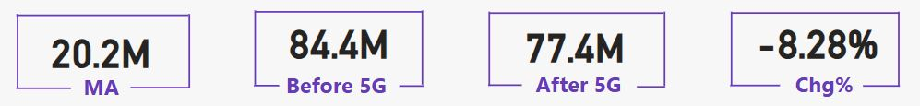
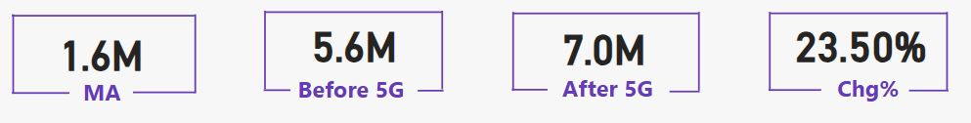
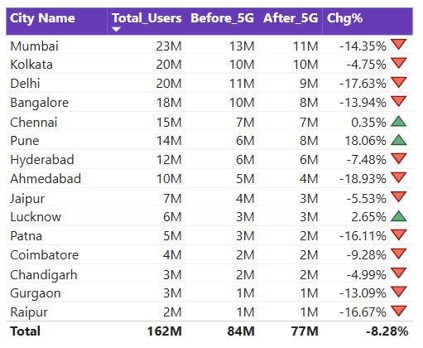
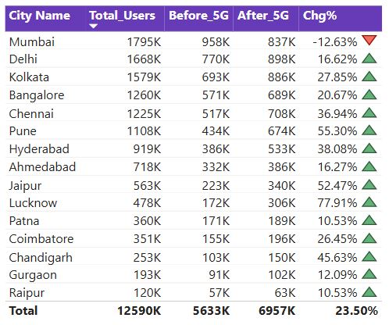
PROBLEM STATEMENT
2
Which KPI is underperforming after the 5G launch ?
Total Active Users
Total Un-subscribed Users
T1
Key Observations
Key Observations
T1
T2
Active users dropped from 84.4M to 77.4M, a decline of 8.28%
13 out of 15 cities experienced a drop in active users
Unsubscribed users rose from 5.6M to 7.0M, an increase of 23.50%
14 out of 15 cities saw growth in unsubscribes
T2
T3
T3

Slide 10
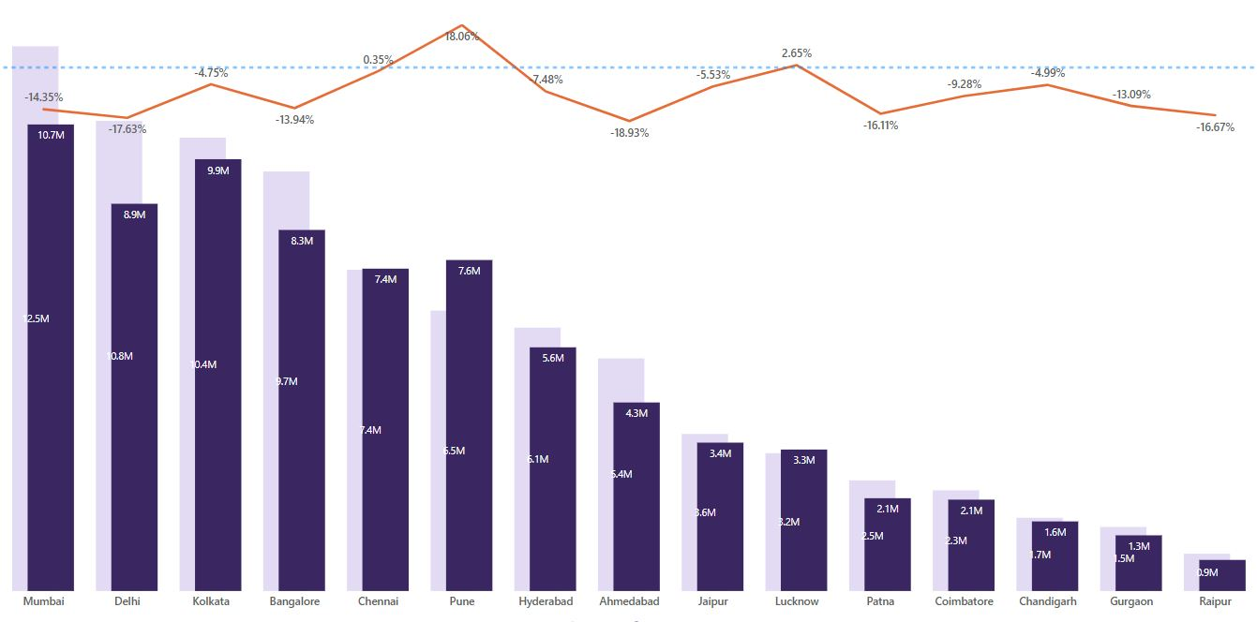
Business Concerns
Indicates post-5G drop in engagement and user satisfaction
High drop in Tier-1 cities could impact ARPU and retention
Only Chennai showed a marginal increase (+0.35%) in active users
Active Users : Before 5G vs After 5G
Major cities with highest decline:
Ahmedabad -18.93% (T2)
Pune -18.06% (T2)
Delhi -17.63% (T1)
Patna -16.11% (T3)
Mumbai -14.35% (T1)
Bangalore -13.94% (T1)
Recommendations
Conduct user sentiment surveys in top-declining cities
Perform 5G network quality audits in cities like Delhi and Pune
Launch targeted retention campaigns with improved offers or benefits
Study Chennai’s approach for replication in underperforming markets

Slide 11
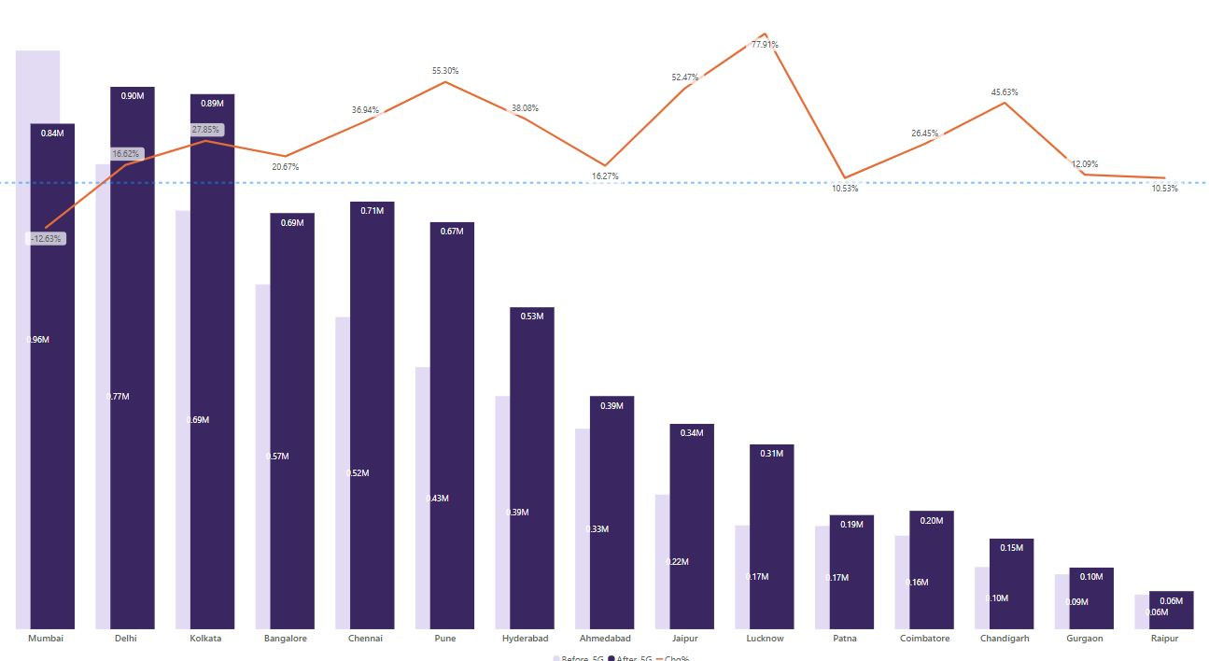
Business Concerns
Suggests customer dissatisfaction or unmet 5G expectations
Massive churn in Tier-2 cities highlights gaps in onboarding or value delivery
Mumbai was the only city with reduced churn (-12.63%), indicating successful transition
Un-Subscribed Users : Before 5G vs After 5G
Cities with highest surge in churn:
Lucknow 77.91% (T2)
Jaipur 52.47 (T2)
Pune 55.30% (T2)
Chennai 36.94% (T1)
Hyderabad 38.08% (T2)
Recommendations
Run exit/churn diagnostics to identify key pain points
Launch win-back campaigns with targeted messaging and incentives
Focus on value communication and customer education in Tier-2 cities
Analyse Mumbai’s success to derive scalable retention strategies

Slide 12
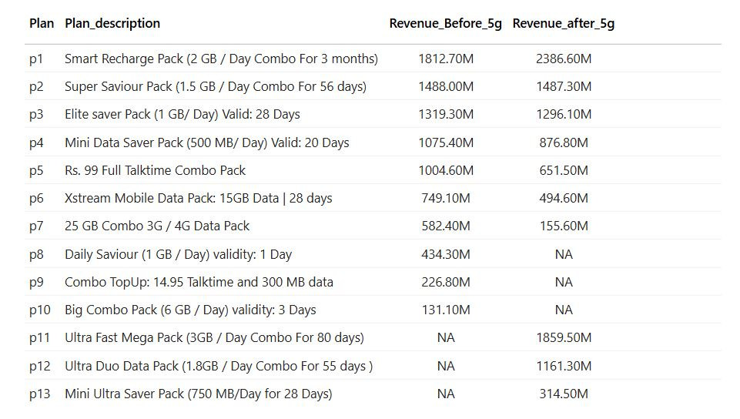

PROBLEM STATEMENT
3
After the 5G launch , which plans are performing well in terms of revenue ? Which plans are not performing well ?
Key Observations
📈 Top Performing Plans: P1, P11, P12 🟡 Stable Plan: P2 🔻 Declining Plans: P3, P4, P5, P6, P7 ❌ Discontinued After 5G Launch: P8, P9, P10 🆕 New Plans Launched Post 5G: P11, P12, P13

Slide 13
High Performing Plans
Stable or Neutral Performer
P1
P2 – Super Saviour Pack (1.5 GB /Day Combo for 56 Days)
Revenue almost unchanged: 1488.00M → 1487.30M
Indicates a loyal user base but no growth.
Refresh the offering with bundled perks (e.g., streaming, weekend boost).
Monitor closely for churn signals.
P1 – Smart Recharge Pack (2GB /Day Combo for 3 Months)
Revenue increased from 1812.70M to 2386.60M
Long validity and 2GB/day makes it highly attractive for 5G users.
P11 – Ultra Fast Mega Pack (New Plan) (3GB/Day Combo for 80 Days)
Revenue after 5G: 1859.50M
Strong 3GB/day offer meets heavy usage needs – gamers, streamers, professionals.
P12 – Ultra Duo Data Pack (New Plan) (1.8GB /Day combo for 55 Days)
Revenue after 5G: 1161.30M
Balanced daily data for moderate users; strong adoption.
Continue investing in marketing.
Highlight 5G benefits and speed.
Offer bundles with OTT/gaming apps.
P2
P11
Recommendation
Underperforming Plans
P3
P12
P3 – Elite Saver Pack: -23.2M (1GB/Day Valid 28 Days) P4 – Mini Data Saver Pack: -198.6M (500 MB /Day Valid 20 Days) P5 – Rs. 99 Talktime Pack: -353.1M
P6 – Xtream Mobile Data: -254.5M (15GB Data 28 Days) P7 – 25 GB Combo Pack: -426.9M
Users shifting to high-data, long-validity, or 5G-optimized plans.
Outdated structures (low MB/day, 3G/4G packs) no longer appealing.
Revamp or retire these plans.
Introduce modern equivalents with daily data and 5G compatibility.
P4
P5
P6
Recommendation
Insights
P7
Recommendations

Slide 14
Discontinued Plans (No Post 5G data) ❌
Strategic Recommendations
P8 P9 P10
P8 – Daily Saviour (1GB /Day Valid 1 Day)
P9 – Combo Top-Up (14.95 Talk time and 300 MB Data)
P10 – Big Combo Pack (6GB/Day Valid 3 Days)
Possibly discontinued due to low demand or 5G incompatibility.
Promote high-performing plans through targeted 5G marketing.
Retire out low-performing and outdated plans (P3–P7).
Offer personalized upgrade nudges to legacy plan users.
Bundle streaming, cloud storage, or gaming with top plans.
Track migration behaviour from discontinued plans to optimize future offerings.
Introduce auto-switch plans based on usage patterns.
New Plans Launched 🆕
P11 – Ultra Fast Mega Pack: 1859.50M (3GB/Day Combo for 90 Days) P12 – Ultra Duo Data Pack: 1161.30M (1.8 GB/Day for 55 Days) P13 – Mini Ultra Saver Pack: 314.50M (750 MB/Day for 28 Days)
P11 and p12 are major hits.
P13 has potential as a starter plan.
Monitor churn from discontinued plans.
Use P13 as entry-level; guide users to upgrade to P11/P12.
Insights
Suggestions

Slide 15
PROBLEM STATEMENT
P7
4
Identify the plans most negatively impacted post-5G launch and evaluate whether they should be retained, restructured, or phased out.
Key Observations
P7 – 25 GB Combo Pack 🔻
Before 5G Revenue: 888.6M
After 5G Revenue: 461.7M
Change: 🔻426.9M (largest drop)
The plan is based on 3G/4G technology.
One-time data (25 GB total) without daily split is less relevant in a 5G environment where high-speed usage is more frequent and sustained.
The drop indicates that users are moving to plans offering daily data limits, higher GB, and 5G compatibility.
Insights
Recommendation
Redirect users to 5G-compatible, daily data plans (P1, P11).
Communicate benefits of switching to newer packs to retain customers.

Slide 16
Other Affected Plans (Moderate Drop)
P6 – Xtream Mobile Data (15 GB/month Valid 28 Days) 🔻
Drop: 🔻 254.5M
Monthly lump sum data doesn’t appeal in the age of daily high-speed needs.
🚫 Discontinue or Restructure with daily 5G data and OTT tie-ups.
P6
Recommendation
P5 – Rs. 99 Talktime Pack 🔻
Drop: 🔻 353.1M
Indicates voice-only or minimal data packs are losing value in a 5G-driven, data-heavy market.
🔁 Consider retiring or bundling with small data packs to preserve base users.
P5
Recommendation

Slide 17
PROBLEM STATEMENT
5
Which plans were discontinued following the 5G rollout, and what were the key factors behind their discontinuation?
Key Observations
P8 – Daily Saviour (1GB/Day Valid 1 Day)
Possibly a low-value daily recharge suited for 3G/4G users.
With the launch of data-rich 5G plans, users likely migrated to more powerful, long-validity packs.
Likely discontinued due to reduced demand and relevance in a 5G environment.
2. P9 – Combo Top-Up (14.95 Talktime and 300MB data)
Combines talk time and low data a structure not optimized for 5G usage patterns.
5G users expect faster speed + larger data limits, making such combo packs outdated.
Likely discontinued due to poor data offering and outdated design.
3. P10 – Big Combo Pack (6GB/Day Valid 3 Days)
Despite the name, the revenue was relatively low at 152.6M before 5G.
Suggests it wasn’t adopted widely even before 5G.
Likely discontinued due to low performance and poor value proposition in the 5G era.

Slide 18
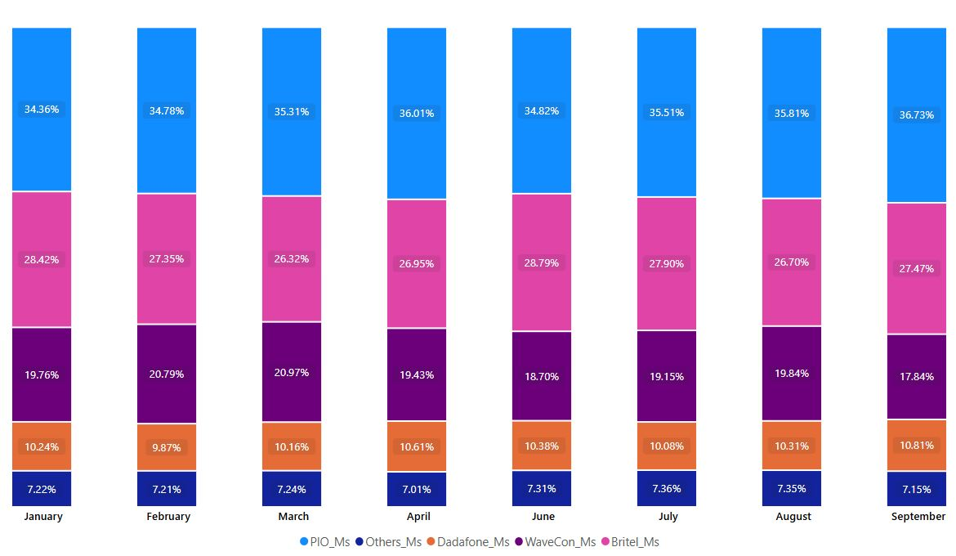
MARKET SHARE ANALYSIS OF WAVECON
Month | WaveCon (%) | Observation
Jan | 19.76 %
Feb | 20.79 % | Strong gain
Mar | 20.97 % | Peak pre-launch
Apr | 19.43 % | Sharp drop right before 5G rollout
May | — | 5G Launch Month
Jun | 18.70 % | Slight recovery post-launch
Jul | 19.15 % | Gain, but still lower than pre-5G peak
Aug | 19.84 % | Nearly back to March level
Sep | 17.84 % | Big drop – lowest across both phases
3rd
Market Share Before 5G
Market Share After 5G
5G
🔼 Positive Signs (Jun–Aug)
Gradual recovery from June to August.
By August, market share touched 19.84%, nearly equal to January levels.
Indicates initial post-5G traction, possibly driven by new plan adoption (P11, P12).
🔻 Alarming Dip in September
Falls to 17.84%, lowest across all months.
This is a -3.13% drop from March’s pre-5G high of 20.97%.
Suggests customer dissatisfaction, plan fatigue, or better competitor offerings.

Slide 19
COMPETITOR`S MARKET SHARE ANALYSIS OF WAVECON
Operator | Trend (Jun–Sep) | Observations
PIO | 34.82% → 36.73% 📈 | Dominant and growing – excellent retention or acquisition
Dadafone | 28.79% → 27.47% 📉 | Losing ground – opportunity for WaveCon
Britel | 10.38% → 10.81% ➕ slight up | Stable player, growing slowly
Others | Around 7.3% steady | No major movement
Period | Peak | Lowest | Net Change
Before 5G | 20.97% (Mar) | 19.43% (Apr) | ↑ +1.21% (Jan–Mar), ↓ −1.54% in Apr
After 5G | 19.84% (Aug) | 17.84% (Sep) | Short-lived gain, ends with ↓ −2.00%
Wavecon Market Share
Key Issues:
📉 Post-5G market share dropped overall, despite short-term gains.
❗ Customers may not be perceiving real value in 5G offerings.
📱 New plans (P11, P12) worked early, but retention is weak.
📍 September’s dip needs immediate attention possibly due to:
Pricing dissatisfaction
Competition offering better speed/data
Poor coverage/performance in Tier-1 cities
Competitors Market Share
PIO gained ~2.4%, while WaveCon lost ~3.1%,
showing competitive shift away from WaveCon post-5G launch.

Slide 20
RECOMMENDATIONS
Re-engage users: Run awareness and satisfaction campaigns to understand churn reasons (especially post-August).
Tiered pricing or regional promotions: Retarget segments with custom 5G bundles, particularly in low-conversion regions.
Benchmark against PIO: Study what’s working for them (likely aggressive data/pricing) and adapt accordingly.
Retain active 5G users: Incentivize upgrades from legacy plans and introduce loyalty-based benefits (e.g., OTT bundles).
Improve September onboarding/offers: New user conversion and retention fell drastically.
💡

Slide 21
THANK YOU

Slide 22
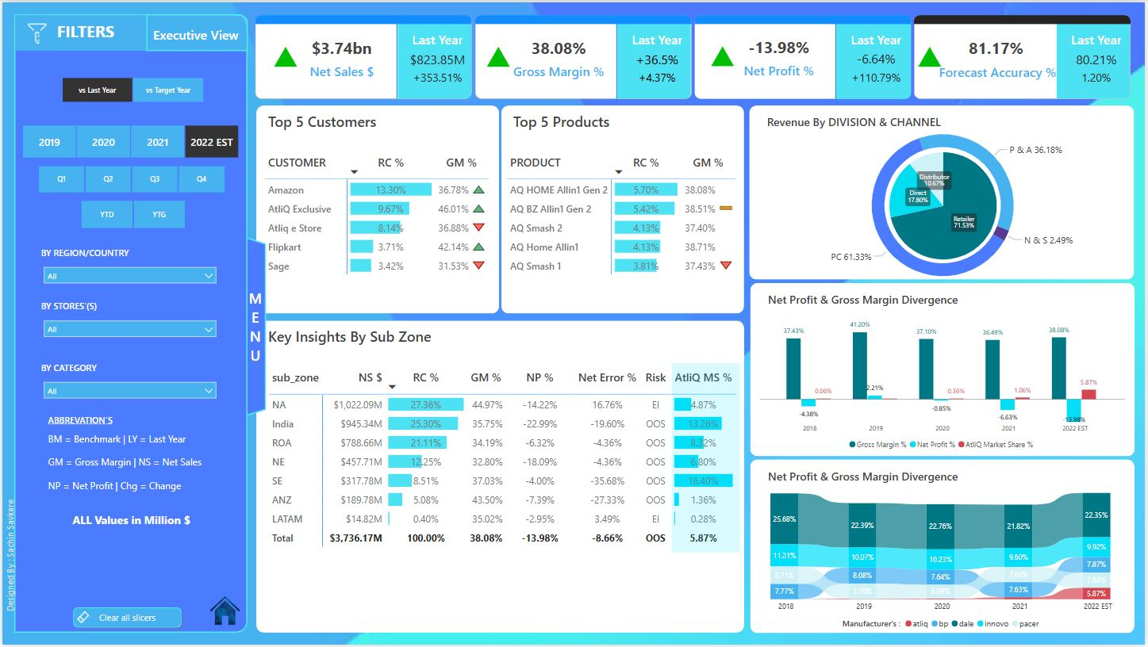
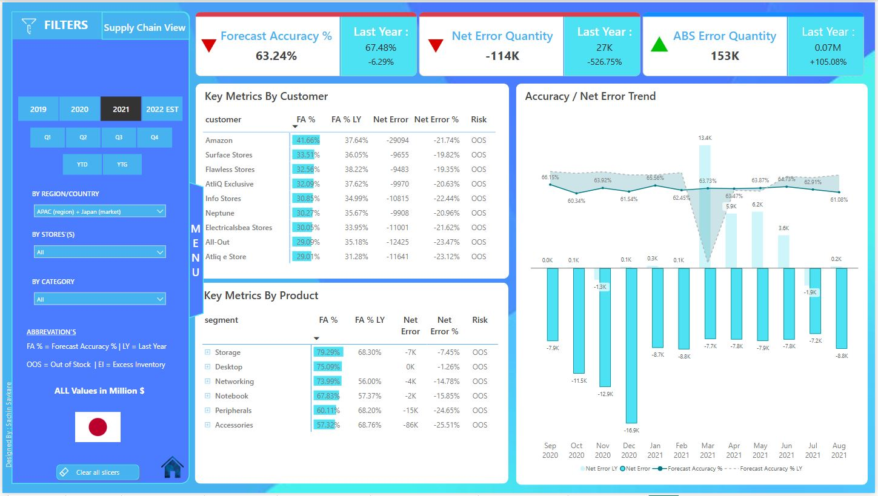
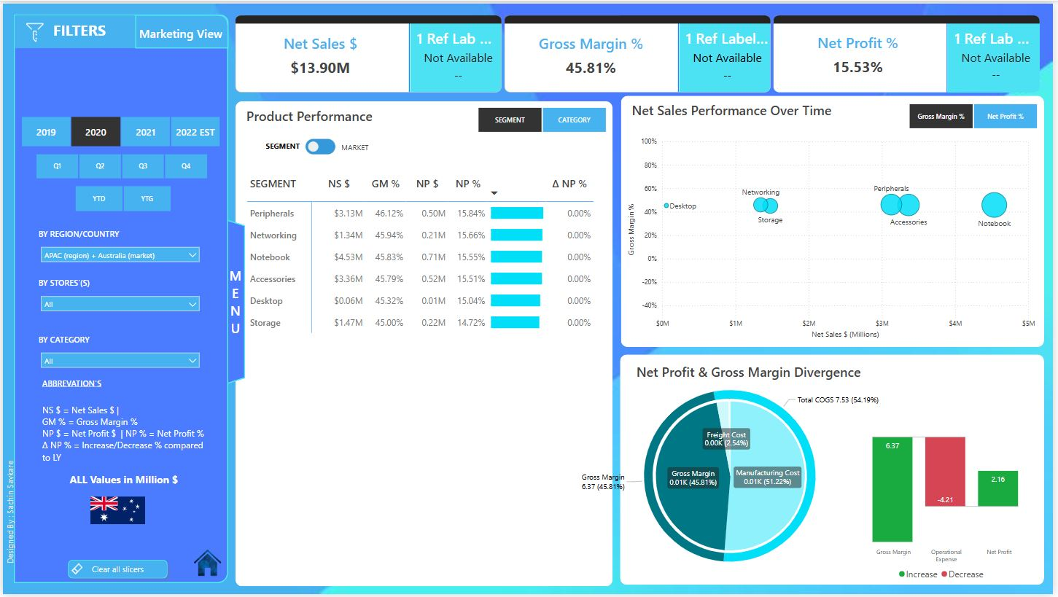
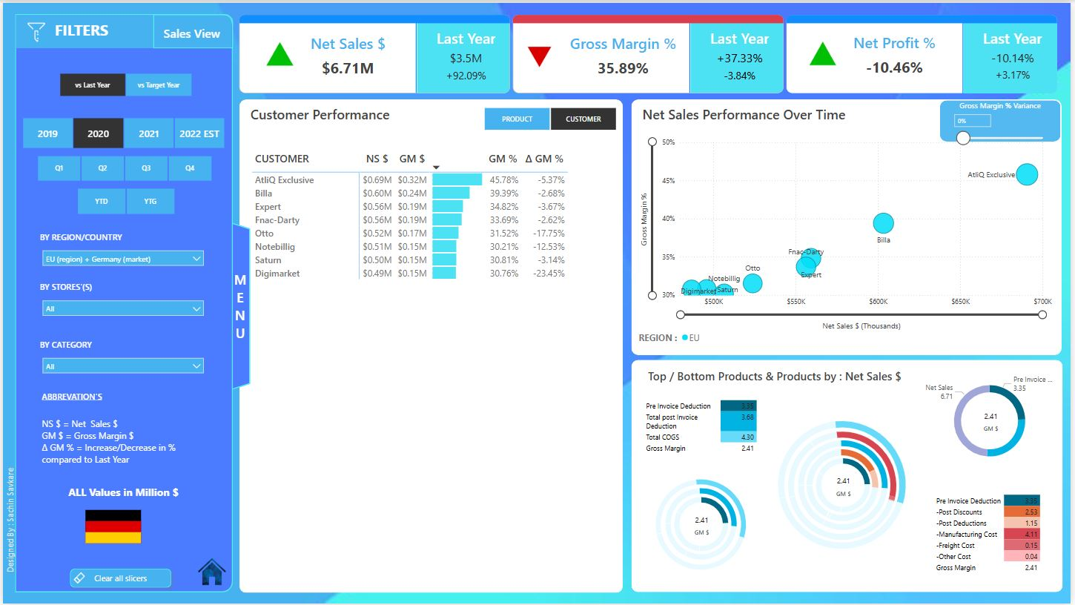
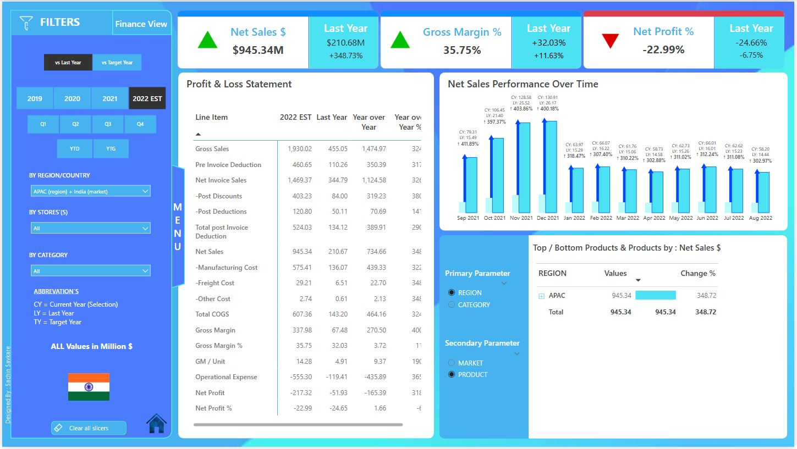
Business Insights 360 | Power BI Dashboard Driving Smarter Decisions Across Finance, Sales, Marketing, Supply Chain & Executive Views

Slide 23
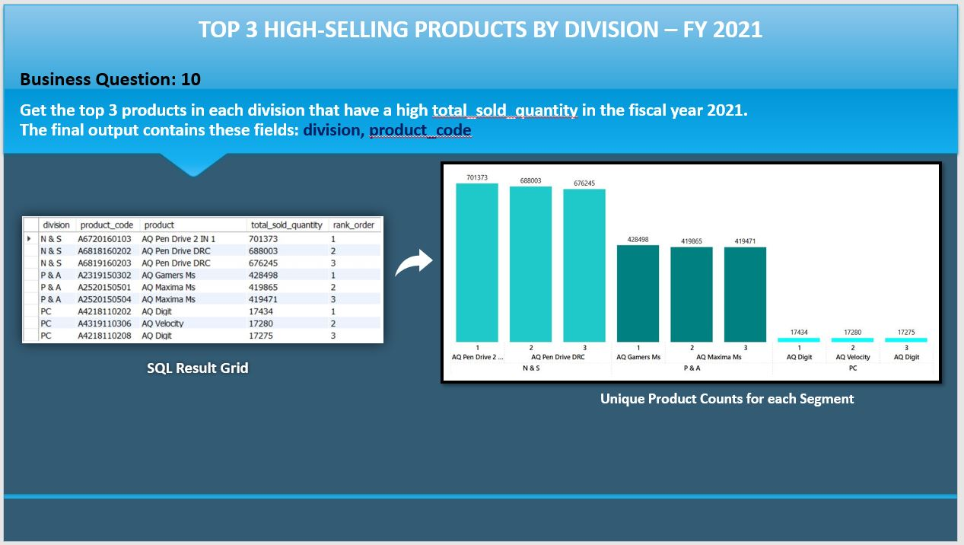
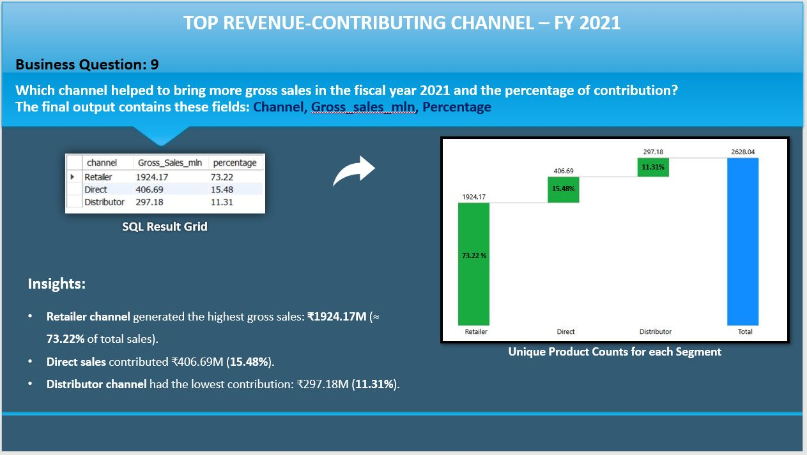
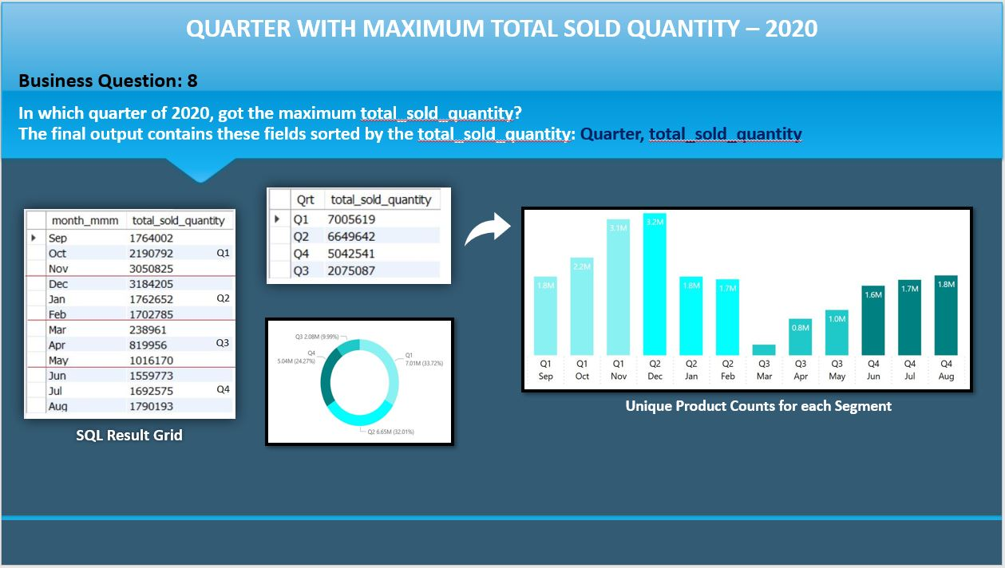
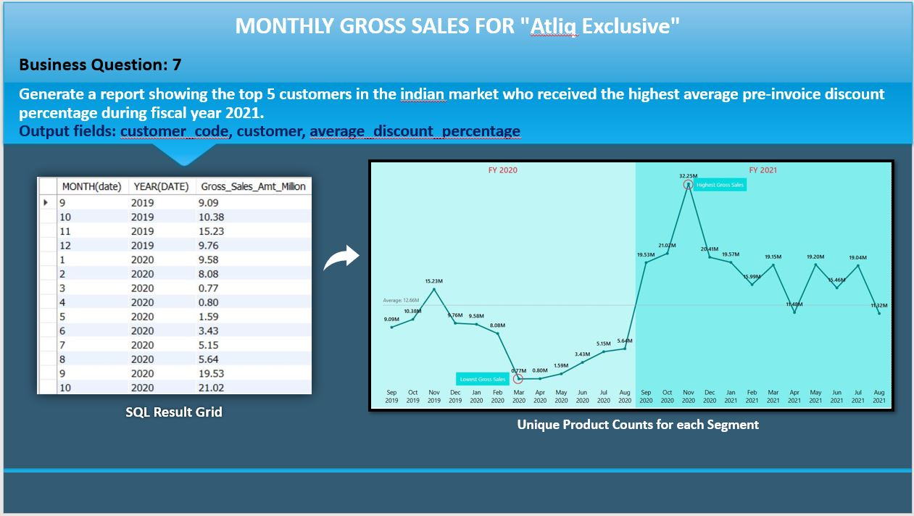
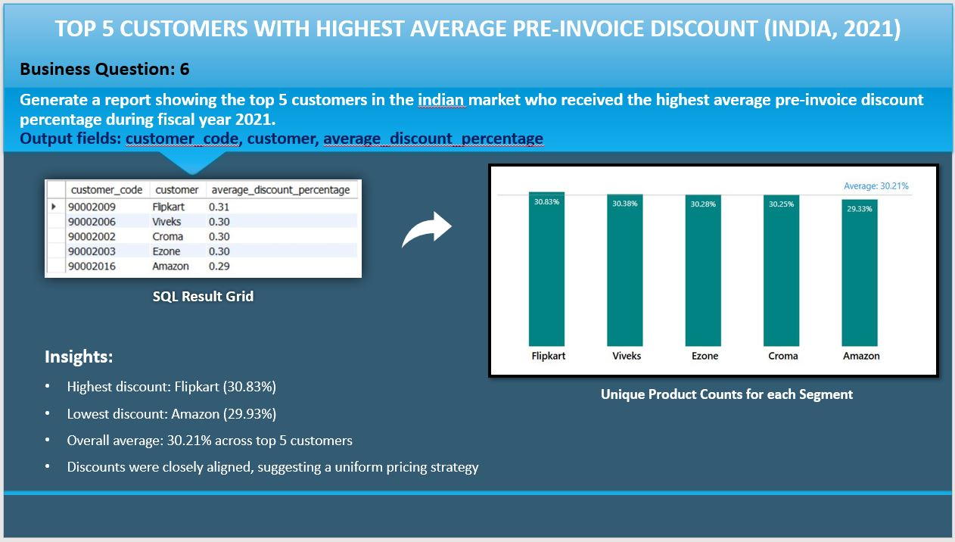
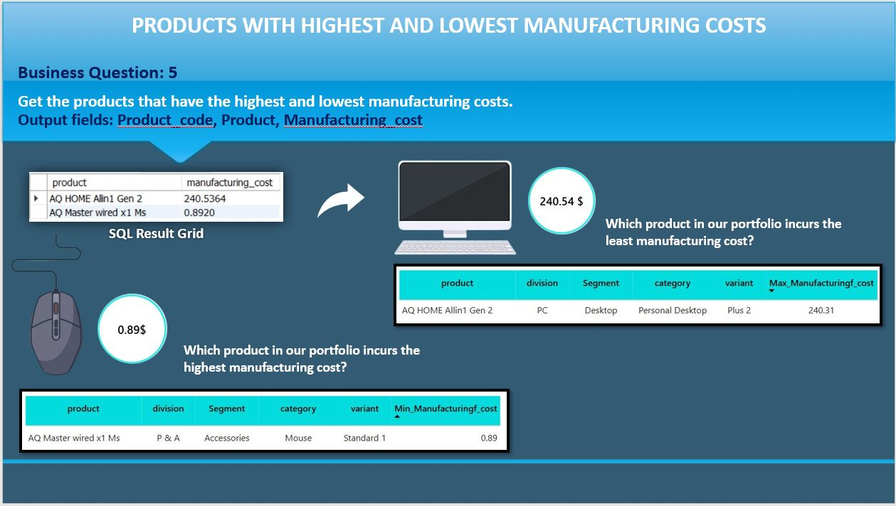
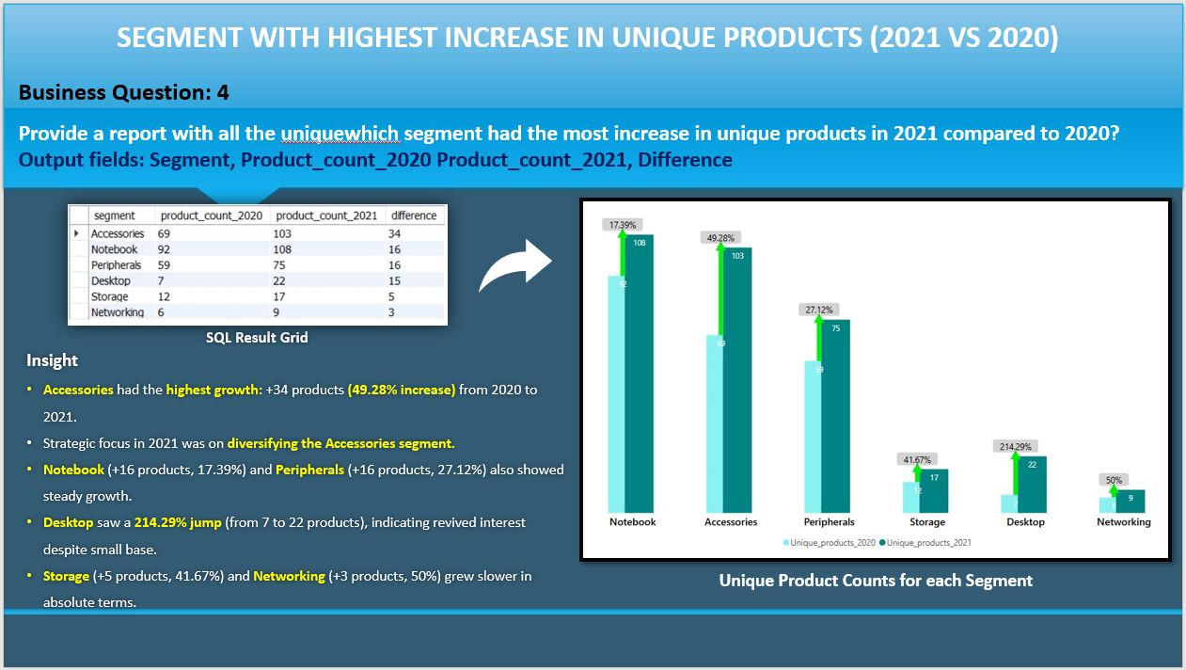
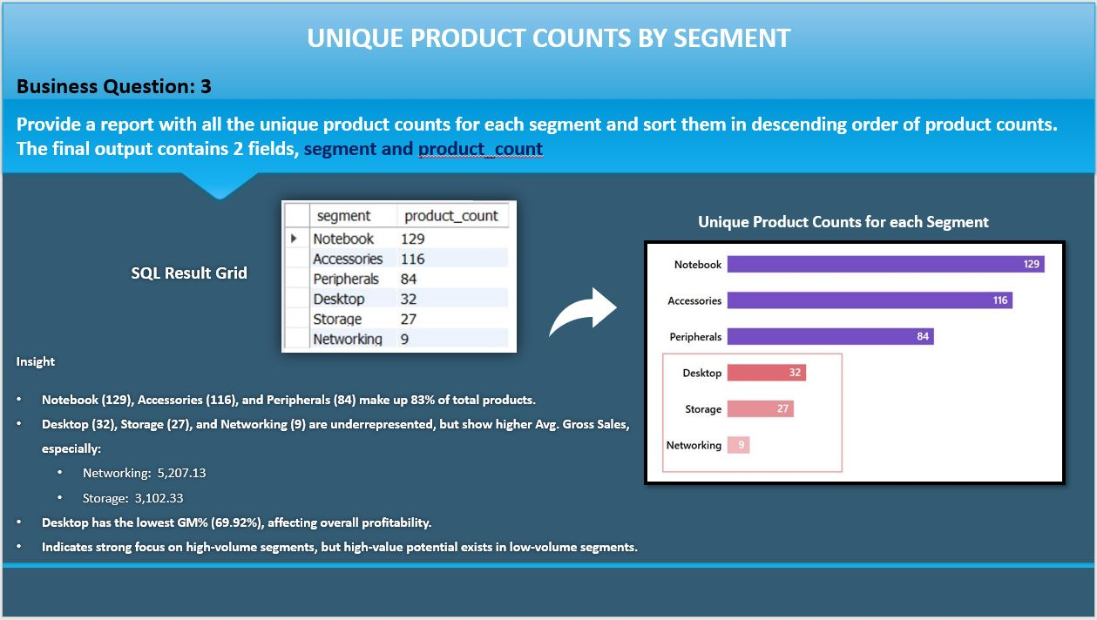
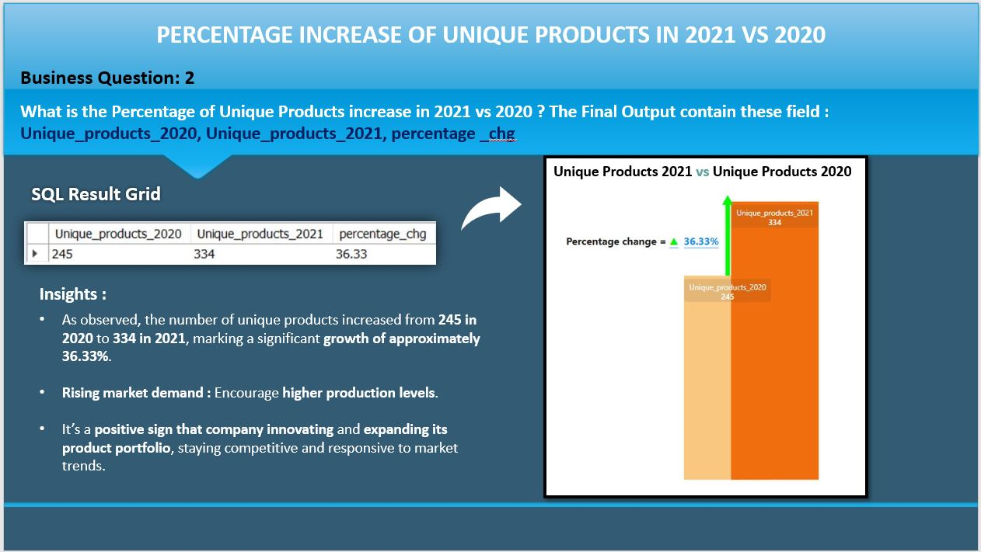
Analysis of 10 Ad-Hoc Requests: SQL Query Results, Strategic Insights, and Data Visualizations for AtliQ Hardware (Consumers Goods)

Slide 24
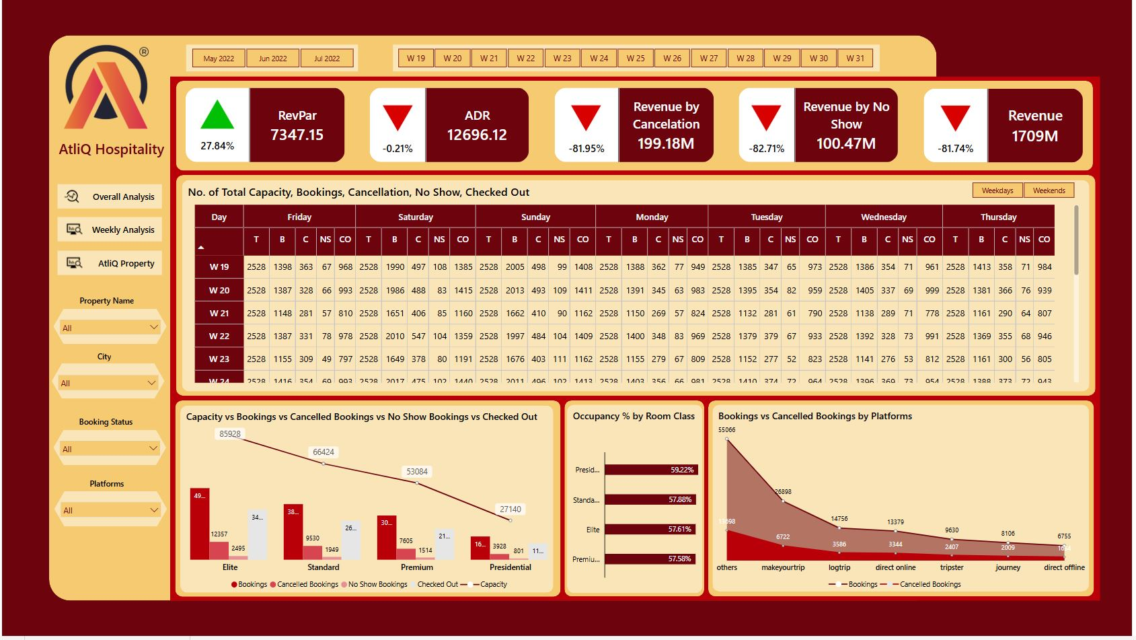
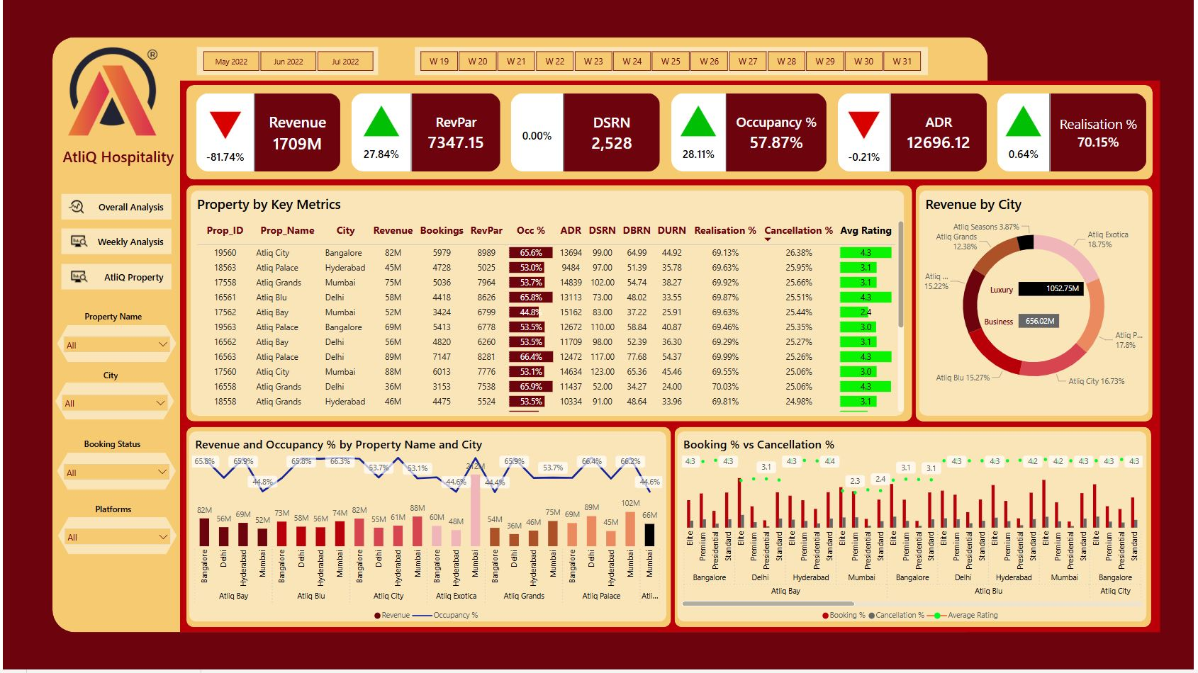
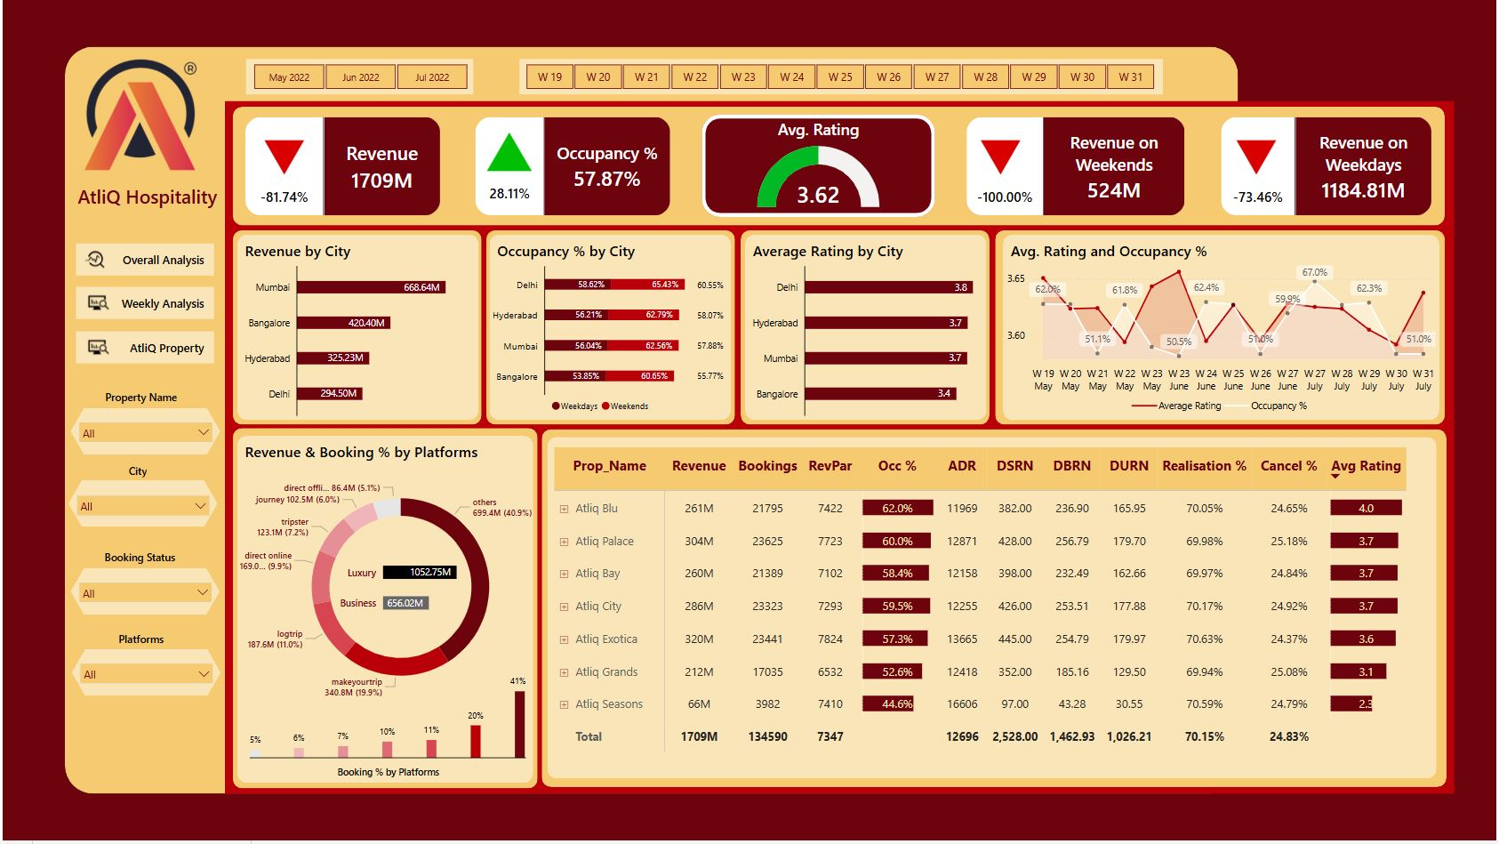
Unlocking Hospitality Growth: Power BI Insights Driving Revenue & Strategy for AtliQ Grands

Slide 25
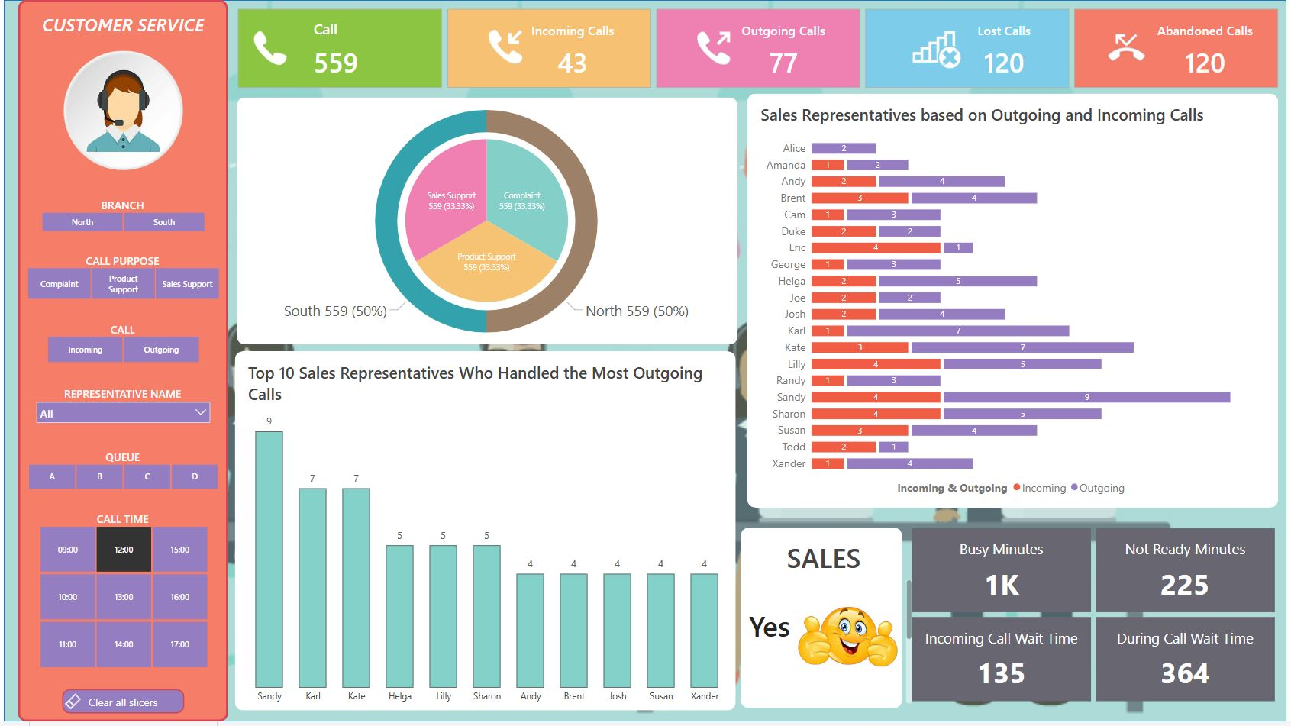
Customer Experience Analytics | Power BI Dashboard for Operational Insights

Slide 26
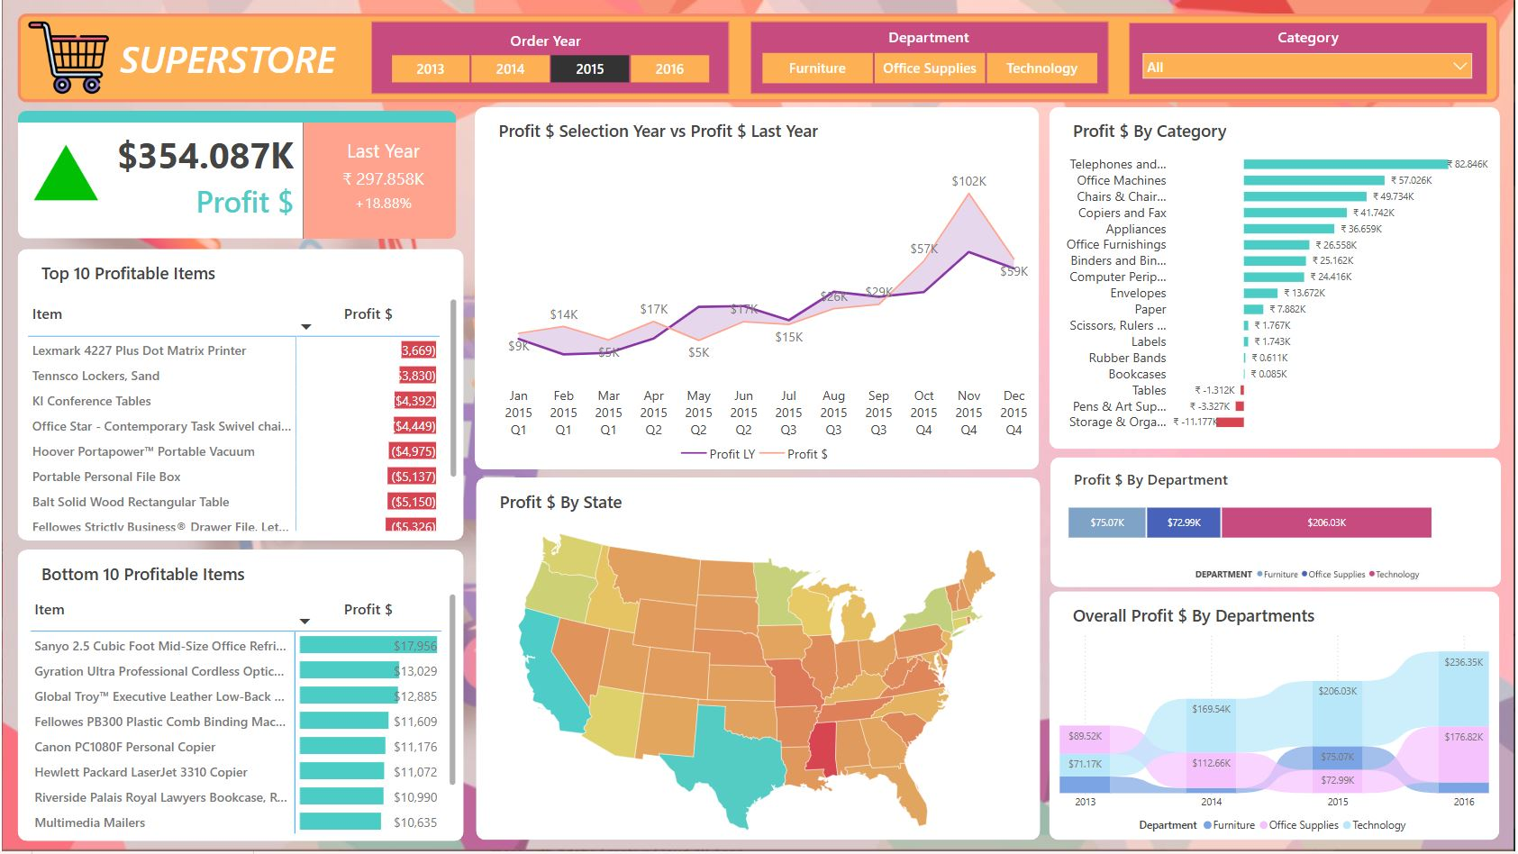
Consumer Goods | Superstore Analysis: Turning Data into Decisions with Power BI

